Slide 1
Math 152 – Lesson 18
Lesson | Topic | Reading
15/16 | Work/Ave Value of a Function | 6.4/6.5
17/18 | Applications to Physics & Eng | 8.3
19 | Modeling w/ Diff Eq/Dir Fields | 9.1/9.2
Objectives:
Compute hydrostatic pressure & force at a specific depth
Develop & evaluate a definite integrals to determine hydrostatic forces

Slide 2

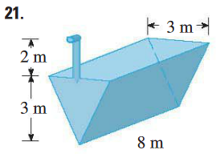
Review
Setup but do not solve
Notes:
Define h from top of trough
ρg = 62.5lb/ft^3
W = F D
D = 2 + h
F = ma
a = g
m = (density)(volume), ρ = density
volume (of slice) = 8(3-h)dh
W = $integral\left(from 0 to 3\right)of (\text{ρ}\text{8(3−}\text{h}\text{)}\text{g}\text{(2+}\text{h}\text{)}\text{dh}$

Slide 3
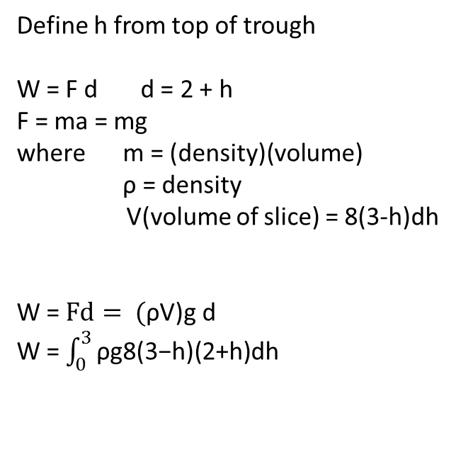
Review
Define h from top of trough
W = F d d = 2 + h
F = ma = mg
where m = (density)(volume)
ρ = density
V(volume of slice) = 8(3-h)dh
W = $Fd= \text{(}\text{ρ}\text{V}\text{)}\text{g} \text{d}$
W = $\int_{0}^{3}{\text{ρ}\text{g}\text{8(3−}\text{h}\text{)(2+}\text{h}\text{)}\text{dh}}$
1.5 m
a
h
3 m
3-h
Similar Triangles: a = 0.5(3-h)
Width = 2a = 3-h
Notes:
Define h from top of trough
ρg = 62.5lb/ft^3
W = F D
D = 2 + h
F = ma
a = g
m = (density)(volume), ρ = density
volume (of slice) = 8(3-h)dh
W = $integral\left(from 0 to 3\right)of (\text{ρ}\text{8(3−}\text{h}\text{)}\text{g}\text{(2+}\text{h}\text{)}\text{dh}$

Slide 4

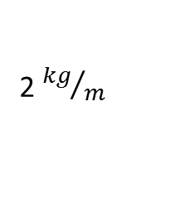
Desk Work - Pulling
Find the work required
to lift the sandbag to a
height of 50 m
2. Find the work required
to lift the sandbag 50 m
assuming it is leaking
1 kg of sand for each
meter it is lifted
2 ${kg}/m$
100 m
500 kg
Notes:
1) Rope Length = (100 - h)(m)
Rope mass = (100 – h)(m)(2kg/m) = (200 – 2h)kg
Sandbag mass = 500kg
Total MASS = (700 – 2h)kg
Total FORCE = (700 – 2h)kg(9.8m/s s) = 9.8(700 – 2h)N
Work = F D. the TOTAL “D” = 50m, made up of increments of “dh”
W = 9.8ʃ $(\text{700 – 2}\text{h}\text{)}\text{dh}\text{ = 700}\text{h}\text{ −}{ (h}^{2 }),evaluated from 0 to 50m$
= 9.8[(700(50) - ${ (50}^{2 })) −(0)]=9.8[35000 −2500]=9.8(32500)=318500 N m$
2) Rope Length = (100 - h)(m)
Rope mass = (100 – h)(m)(2kg/m) = (200 – 2h)kg
Sandbag mass = (500 – 1h)kg
Total MASS = (700 – 3h)kg
Total FORCE = (700 – 3h)kg(9.8m/s s) = 9.8(700 – 3h)N
Work = F D. The TOTAL “D” = 50m, made up of increments of “dh”
W = 9.8ʃ $(\text{700 – 3}\text{h}\text{)}\text{dh}\text{ = 700}\text{h}\text{ −}{ (\frac{3}{2})(h}^{2 }),evaluated from 0 to 50m$
= 9.8[(700(50) - ${ (\frac{3}{2})(50}^{2 })) −(0)]=9.8[35000 −3750]=9.8(31250)=306250 N m$

Slide 5
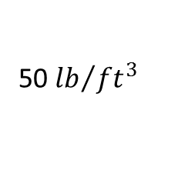
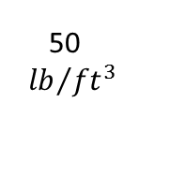
Work - Pumping
How much work is required to pump the fuel out of the upper nozzle? SETUP BUT DO NOT SOLVE
10 ft
10 ft
100 ft
100 ft
50
${lb}/{{ft}^{3}}$
50 ${lb}/{{ft}^{3}}$
50 ft
50 ft
Notes:
Slice weight(force) = (volume)(density)= (π$r^{2}$dh)(50 ${lb}/{{ft}^{3}}$)
Integrate W = FD = ʃ(π$r^{2}$)(50 ${lb}/{{ft}^{3}}$)(h)dh from 50 to 100
= 50π$r^{2}$ʃhdh from 50 to 100
= 25π${(10)}^{2}$(${100}^{2}$ - ${50}^{2}$) = 58.9e6 ft lb
----------------------------
r(h) = (a)h + b
r(0) = 10 = 0a + b, b = 10
r(100) = 0 = 100a + 10, a = (-1/10)
r(h) = 10 – h/10
Slice weight(force) = (volume)(density)= (π$r^{2}$dh)(50 ${lb}/{{ft}^{3}}$) = 50π${(10 −\frac{h}{10})}^{2}$dh
W = FD = 50πʃh${(10 −\frac{h}{10})}^{2}$dh = 50π(50h^2 – (2/3)h^3 + h^4/400) from 50 to 100
= 50π[50(100^2 – 50^2) – (2/3)(100^3 – 50^3) + (1/400)(100^4 – 50^4)] = 26041.67 ft lb

Slide 6
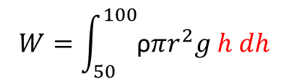
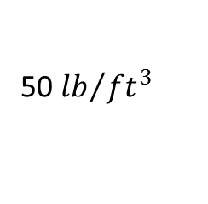
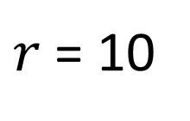
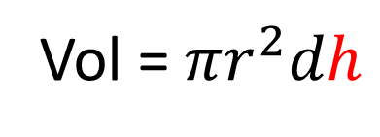
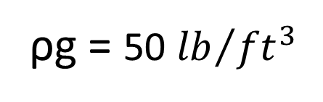
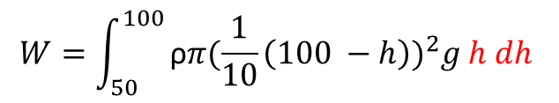
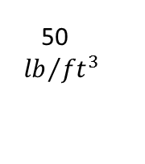
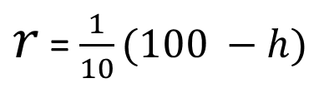
Work – Pumping Solutions
How much work is required to pump the fuel out of the upper nozzle?
W = F D
10 ft
D = h
10 ft
F = m a
a = g
100 ft
h
m = ρ(Vol)
h
100 ft
Vol = $πr^{2}dh$
$r$ = 10
$r$ = $\frac{1}{10}(100 −h)$
50
${lb}/{{ft}^{3}}$
50 ${lb}/{{ft}^{3}}$
ρg = 50 ${lb}/{{ft}^{3}}$
50 ft
50 ft
$$W=\int_{50}^{100}{\text{ρ}πr^{2}g h dh }$$
$$W=\int_{50}^{100}{\text{ρ}π{(\frac{1}{10}\left(100 −h\right))}^{2}g h dh }$$
Notes:
Slice weight(force) = (volume)(density)= (π$r^{2}$dh)(50 ${lb}/{{ft}^{3}}$)
Integrate W = FD = ʃ(π$r^{2}$)(50 ${lb}/{{ft}^{3}}$)(h)dh from 50 to 100
= 50π$r^{2}$ʃhdh from 50 to 100
= 25π${(10)}^{2}$(${100}^{2}$ - ${50}^{2}$) = 58.9e6 ft lb
----------------------------
r(h) = (a)h + b
r(0) = 10 = 0a + b, b = 10
r(100) = 0 = 100a + 10, a = (-1/10)
r(h) = 10 – h/10
Slice weight(force) = (volume)(density)= (π$r^{2}$dh)(50 ${lb}/{{ft}^{3}}$) = 50π${(10 −\frac{h}{10})}^{2}$dh
W = FD = 50πʃh${(10 −\frac{h}{10})}^{2}$dh = 50π(50h^2 – (2/3)h^3 + h^4/400) from 50 to 100
= 50π[50(100^2 – 50^2) – (2/3)(100^3 – 50^3) + (1/400)(100^4 – 50^4)] = 26041.67 ft lb

Slide 8
Applications
What is the mass of the liquid in each?
What is the Force & Pressure exerted on the ground?
What is the Hydrostatic Pressure & Force at the bottom of the tank?
10 ft
100 ft
100 ft
50 ft
50 ft
10 ft
Notes:
m= ρ(Vol)
Vol = hπr^2 = 50*π10^2
Vol = 1/3π(r100^2 h100 – r50^2 h50) note: need to subtract off the empty top, can’t just do ½ since more volume in bottom half
F = ma, P = F/A, A = πr^2
P = ρgh, where h = 50ft. F = PA where A = πr^2

